Slide 2

Technology Industries of Finland
Technology industries is the largest and most important export sector in Finland
50% of total Finnish exports
6 billion euros annual investments in Finland
70% of total private-sector R&D investments
317 000 employed directly, indirectly over
670 000
Technology Industries of Finland has 1 600 member companies

Slide 3

Technology Industries of Finland
Technology industries’ five sub-sectors
MECHANICAL ENGINEERING
Abloy, Cargotec, Kone, Metso Outotec, Meyer Turku, Normet, Patria, Ponsse, Valmet, Wärtsilä…
INFORMATION TECHNOLOGY
Basware, Bilot, Capgemini, CGI, Digia, Enfo, F-Secure, Fujitsu, Gofore, IBM, Innofactor, Microsoft, Nixu, TietoEVRY…
ELECTRONICS AND ELECTRO-
TECHNICAL INDUSTRY
ABB, Ensto, Murata Electronics, Nokia, Planmeca, Polar Electro, Suunto, Vaisala…
CONSULTING ENGINEERING
AFRY, A-Insinöörit, Citec, Elomatic, Etteplan, FCG, Granlund, Neste Engineering, Ramboll, Sitowise, SWECO, WSP...
METALS INDUSTRY
Boliden, Componenta, Luvata, Outokumpu, Ovako, Sacotec, SSAB …

Slide 4
Technology Industries Finland Skills Pulse 2021

Slide 5
v

Slide 6
Structural change in personnel increases the demand for higher education

Slide 7
¾ of new employees should have studied technology or ICT

Slide 8
87 % of companies are interested in hiring international
employees during the next four years

Slide 9
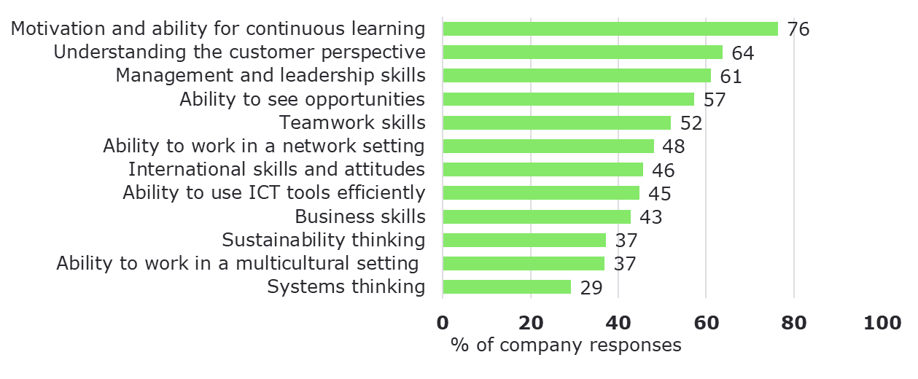
Ability for continuous learning is a key generic competence
Which generic competences will become more important for your business in the coming years?

Slide 10
Digitalisation encompasses a wide range of skills and competences
Business development | Strategic renewal, digital business models, process development, digital enabling green, robotic process automation
Software | Software design, software development, software engineering, programming
Data | Data production and collection, data storage, data warehouses, data analysis and reporting, data management and data architectures
AI | Machine learning, data skills, natural language processing, robotics, supercomputers
Cybersecurity | Processes and technology

Slide 11
Green transition requires both business development competences and technical skills
Business development | Strategic development, change projects, process development, new business models, resource and production management, environmental standards
Low-carbon | Life-cycle thinking, impact assessment, footprint and handprint assesment, electrification, battery technology, energy storage, hydrogen
Circular economy | Business models, life-cycle thinking, engineering design, material and production technology, material flows
Hydrogen technologies | Production processes, hydrogen logistics, fuel cells,, power-to-X, research & consultation

Slide 12
How Skills Pulse was made?
An AI tool was used to identify individual skills and competences from job ads of our member companies, and how the skills and competences link to each other to form ”skills clusters”.
Over 300 member companies participated to the crowdsourcing phase. In the crowdsourcing the companies assessed how important these skills and competences are for their business in the coming years. The participants could also add skills and competences that were missing from the AI analysis.
The AI was used again to gain insight into what kind of competences are linked to the top competences from the crowdsourcing in open access journals and in thesis work.
Companies were also asked to provide an estimate of the net gain or loss in their employees in the coming years. This was added to a statistical estimate of retirees to form an overall estimate of the need for new employees.

Slide 13
Contact us for further information!
Leena Pöntynen
Director, Skills and Competence
+358 40 130 6113
leena.pontynen@teknologiateollisuus.fi
Touko Apajalahti
Higher Education Policy Advisor
+358 40 160 5006
touko.apajalahti@teknologiateollisuus.fi

